Slide 1
Digital Portfolio
STUDENT NAME: N.MOHANA
REGISTER NO :36336324U18031
NM ID:
DEPARTMENT: BSC( COMPUTER SCIENCE)
COLLEGE:SREE ABIRAAMI ARTS AND SCIENCE COLLEGE

Slide 2
PROJECT TITLE
EDUNET FORNT END WEB DEVELEPOMENT

Slide 3


AGENDA
Problem Statement
Project Overview
End Users
Tools and Technologies
Portfolio design and Layout
Features and Functionality
Results and Screenshots
Conclusion
Github Link
3/21/2024 Annual Review

Slide 4

PROBLEM STATEMENT
Identify and address challenges in [specific area or field], aiming to develop innovative solutions that improve efficiency, user experience, or functionality. This project showcases problem-solving skills through research, design, and implementation of effective, real-world applications.

Slide 5

PROJECT OVERVIEW
This project focuses on designing and implementing a [brief description], aimed at solving [specific problem]. It highlights key skills in research, development, and execution, delivering a practical solution that enhances [user experience, efficiency, or functionality]

Slide 6
WHO ARE THE END USERS?
The end users are [specific group, e.g., students, professionals, small business owners] who seek [benefit or solution]. This project is designed to meet their needs by providing [features or improvements] that enhance their daily tasks and overall experience.

Slide 7

TOOLS AND TECHNIQUES
This project utilizes [list key tools, e.g., Python, Adobe XD, SQL] and techniques such as agile development, user-centered design, and data analysis. These methods ensure efficient workflow, accurate results, and a seamless user experience, demonstrating a strong blend of technical and strategic skills.”

Slide 8
POTFOLIO DESIGN AND LAYOUT
The portfolio features a clean, intuitive design with a user-friendly layout that highlights projects clearly. It uses consistent typography, balanced visuals, and responsive elements to ensure accessibility across devices, creating an engaging and professional presentation that effectively showcases skills and achievements.
8

Slide 9
FEATURES AND FUNCTIONALITY
The portfolio includes interactive navigation, responsive design, and multimedia integration. It showcases projects with detailed descriptions, visuals, and demos, ensuring easy access and engagement. Built with performance and usability in mind, it provides a seamless experience across devices, highlighting both technical skills and creative solutions.

Slide 10

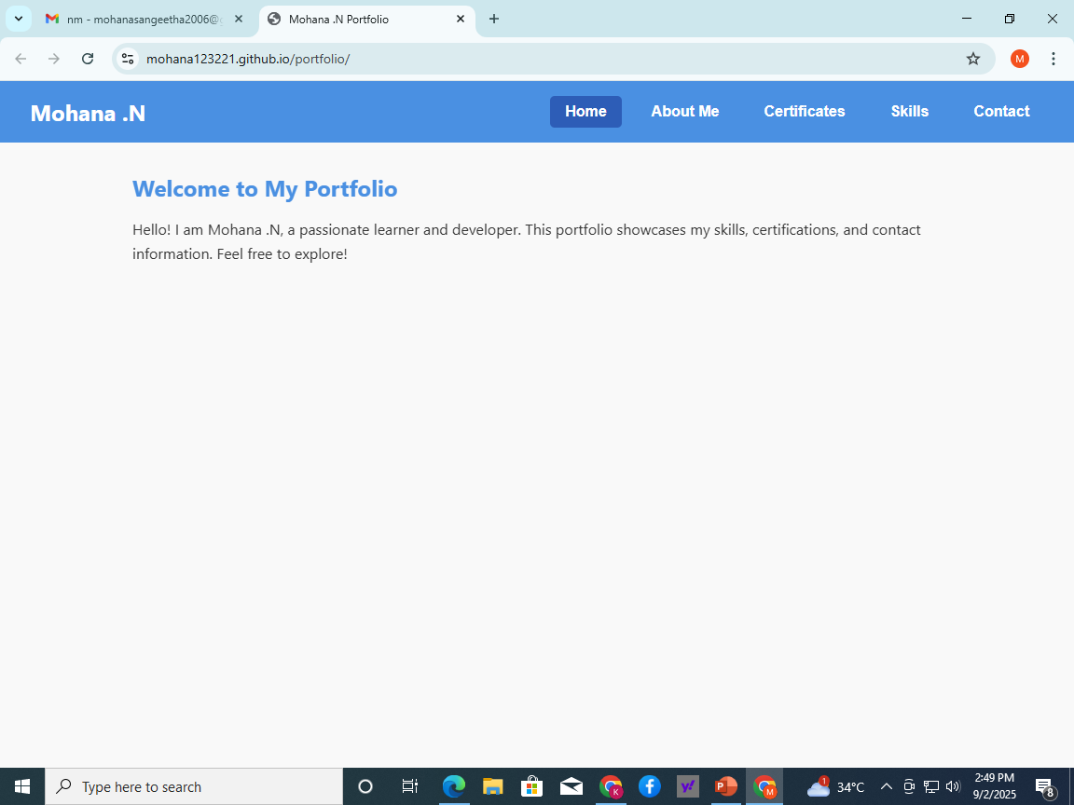
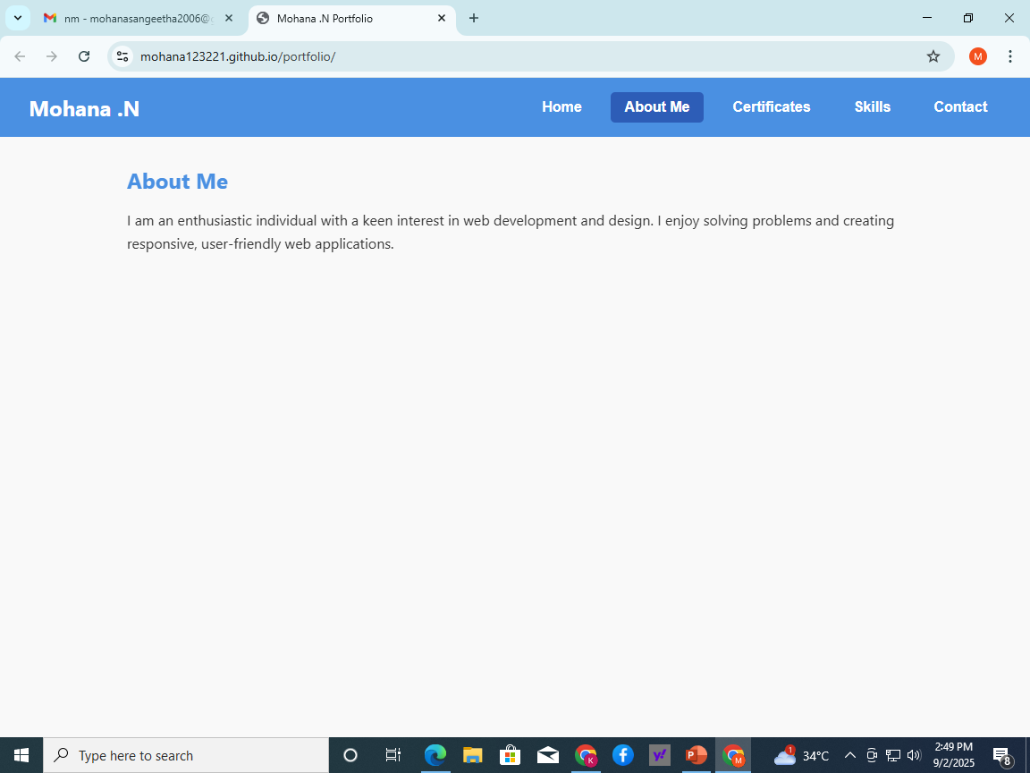
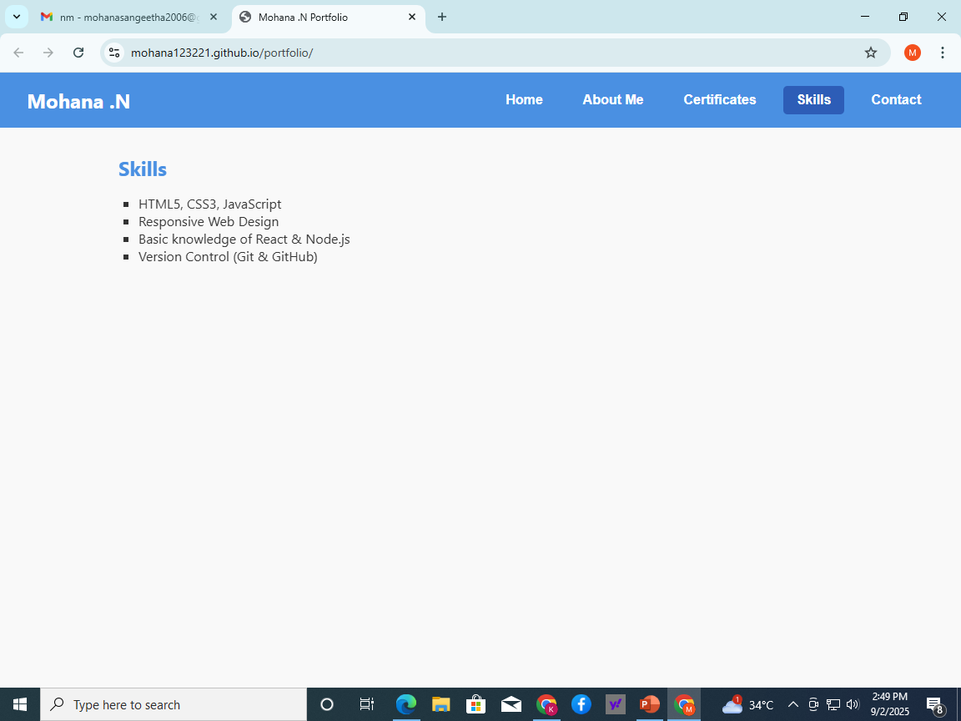
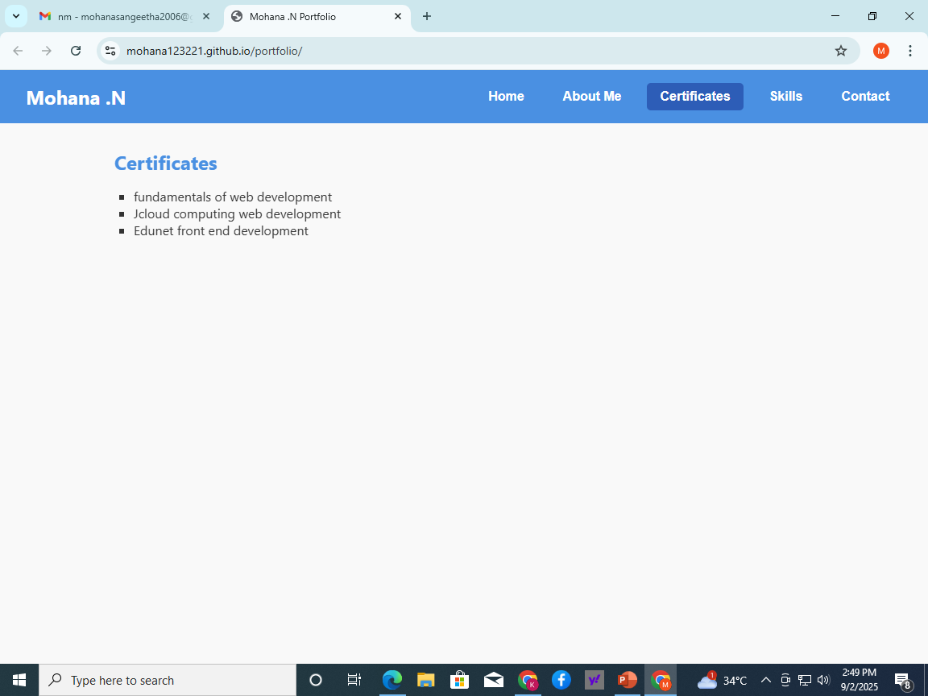
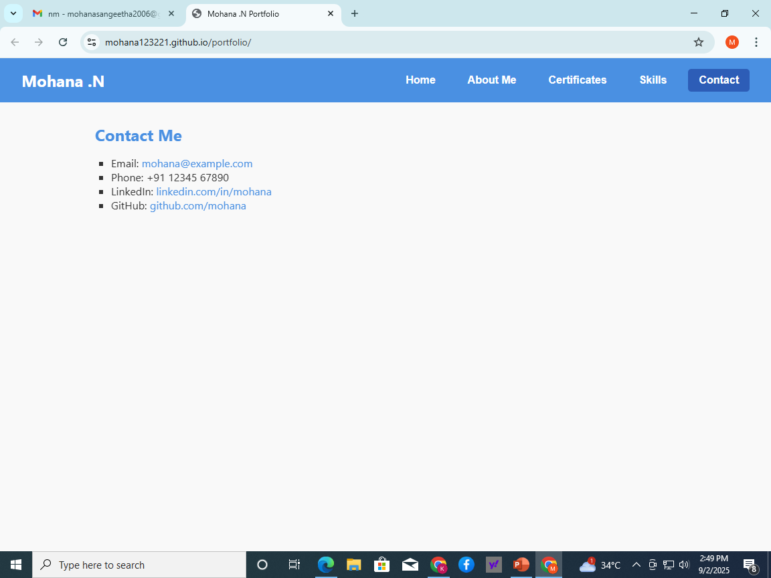
RESULTS AND SCREENSHOTS
3/21/2024 Annual Review
10

Slide 11
CONCLUSION
This portfolio reflects my journey and achievements in computer science, demonstrating strong technical skills and problem-solving abilities. It highlights my commitment to continuous learning and innovation. I am confident that the knowledge and experience showcased here will enable me to contribute effectively to future projects and excel in the ever-evolving tech industry.
11

Slide 12
GITHUB LINK
GITHUB LINK : mohana123221/portfolio
PROJECT RESUME LINK : https://mohana123221.github.io/portfolio/

